Slide 1



AAAI-19: Thirty-Third AAAI Conference on Artificial Intelligence
A Theoretically Guaranteed Deep Optimization Framework for Robust Compressive Sensing MRI
Risheng Liu ^{1,2,*} Yuxi Zhang ^{1,2} Shichao Cheng ^{2,3} Xin Fan ^{1,2} Zhongxuan Luo ^{1,2,3,4}
^{1.} DUT-RU International School of Information Science & Engineering, Dalian University of Technology, Dalian, China
^{2.} Key Laboratory for Ubiquitous Network and Service Software of Liaoning Province, Dalian, China
^{3.} School of Mathematical Science, Dalian University of Technology, Dalian, China
^{4.} Institute of Artificial Intelligence, Guilin University of Electronic Technology, Dalian, China
Dalian University of Technology Feb. 1th, 2019
Report on Feb 1th 2019, at AAAI, by Yuxi Zhang.

Slide 2
OUTLINE
Motivation
Related work
Our Paradigm for CS-MRI
Real-world CS-MRI with Rician Noise
Conclusions

Slide 3
Motivation

Slide 4
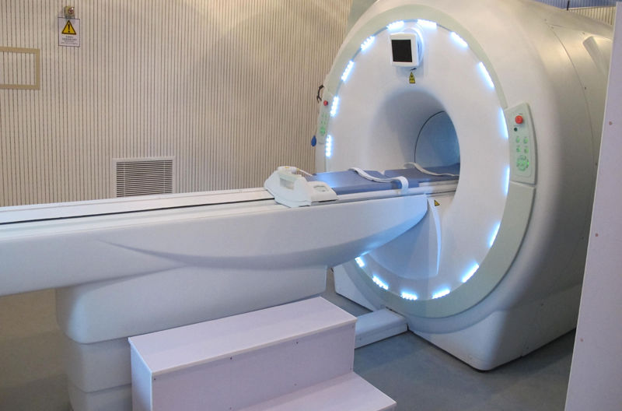
Motivation MRI
Magnetic Resonance Imaging (MRI)
None-invasive
Anatomical information
Slow acquisition
Artifacts introducing
Expensive calculation

Slide 5
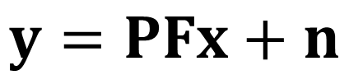
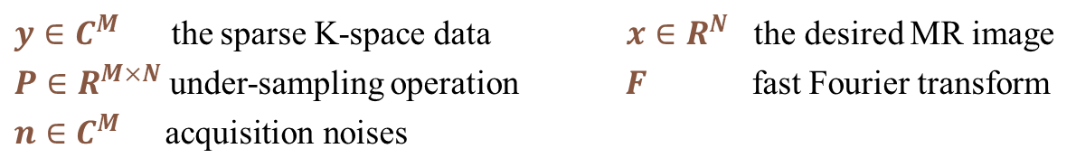
Motivation CS-MRI
Compressive Sensing MRI (CS-MRI)
$$y=PFx+n$$
$y∈C^{M}$ the sparse K-space data $x∈R^{N}$ the desired MR image
$P∈R^{M×N}$ under-sampling operation$F$ fast Fourier transform
$n∈C^{M}$ $\text{acquisition} \text{noises}$
Signal processing based MRI reconstruction
Much lower sampling rate than Nyquist rate
Preserving image quality

Slide 6
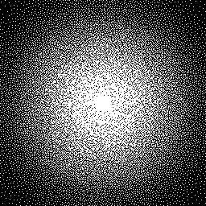
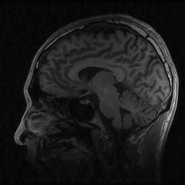
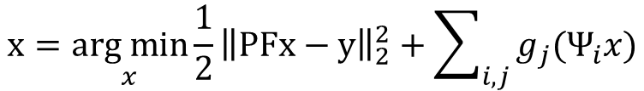
Motivation CS-MRI
Reconstruction of CS-MRI
Sparse K-space Data
Reconstruction Process
Reconstructed MRI
$$x=\underset{x}{arg min}{{\frac{1}{2}\left\|PFx−y\right\|}_{2}^{2}+\sum_{i,j}{g_{j}(Ψ_{i}x})}$$
sparse representation (TV et.al)
wavelet transform (PBDW et.al)
dictionary learning (FDLCP et.al)
non-local method (PANO et.al)
deep learning based (DAGAN et.al)

Slide 7
Motivation problems in existing methods
Model based methods
Model based prior
Satisfying restoration accuracy
High computational cost

Slide 8
Motivation problems in existing methods
Model based methods
Model based prior
Satisfying restoration accuracy
High computational cost
Deep learning based methods
Fast feed-forward process
Data driven prior
Lower flexibility and robustness

Slide 9
Motivation problems in existing methods
Model based methods
Model based prior
Satisfying restoration accuracy
High computational cost
Deep learning based methods
Fast feed-forward process
Data driven prior
Lower flexibility and robustness
Hybrid process based methods
Efficiency improvement
No guarantee on convergence
Sacrificing model based information

Slide 10
Motivation problems in existing methods
Model based methods
Model based prior
Satisfying restoration accuracy
High computational cost
Efficiency
Deep learning based methods
Fast feed-forward process
Data driven prior
Lower flexibility and robustness
Robust
Hybrid process based methods
Efficiency improvement
No guarantee on convergence
Sacrificing model based information
Converged
Accuracy

Slide 11
Our Paradigm for CS-MRI
A Theoretically Guaranteed Deep Optimization Framework
for Robust Compressive Sensing MRI

Slide 12
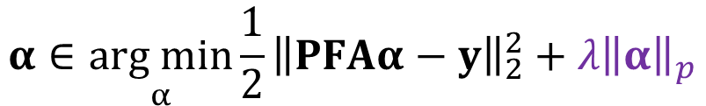
Our Paradigm contributions
CS-MRI optimization model
Sparsity regularization
$$α∈\underset{α}{arg min}{{\frac{1}{2}\left\|PFAα−y\right\|}_{2}^{2}+{λ\left\|α\right\|}_{p}}$$
$α:$sparse code of x$A$: wavelet basis ($x=Aα$)$λ:$ trade-off parameter
Framework composition
Fidelity Module——Reconstruction
Data-driven Module——Artifacts removal
Optimal Condition Module——Error control
Prior Module——Details restoration

Slide 13
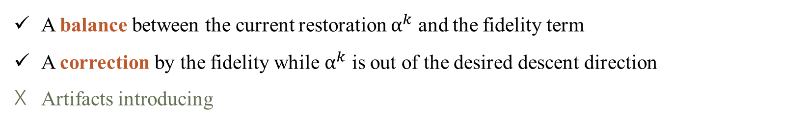
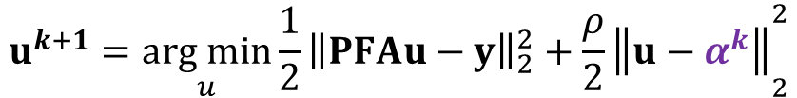
Our Paradigm Fidelity Module
Rough reconstruction
current restoration
$$u^{k+1}=\underset{u}{arg min}{{\frac{1}{2}\left\|PFAu−y\right\|}_{2}^{2}+{\frac{ρ}{2}\left\|u−α^{k}\right\|}_{2}^{2}}$$
Closed form solution
$$u^{k+1}=ℱ\left(α^{k};ρ\right)=A^{T}F^{T}{{(P^{T}P+ρI)}^{−1}(P^{T}y+ρFAα^{k})}$$
Effects
A balance between the current restoration $α^{k}$ and the fidelity term
A correction by the fidelity while $α^{k}$ is out of the desired descent direction
Artifacts introducing

Slide 14
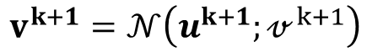
Our Paradigm Data-driven Module
Residual learning network
$$v^{k+1}=𝒩\left(u^{k+1};𝓋^{k+1}\right)$$
Effects
Realizing Artifacts removal
Utilizing Data dependent information utilizing
Providing Fast forward pass process
No guarantee on convergence

Slide 15
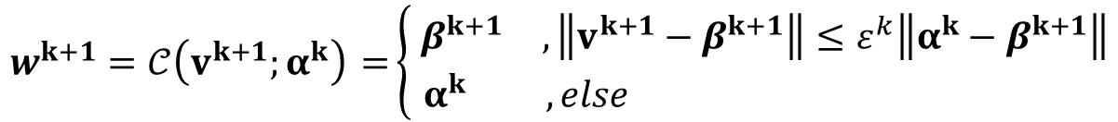
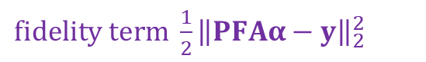
Our Paradigm Optimal Condition Module
Momentum proximal gradient
$fidelity term {\frac{1}{2}\left\|PFAα−y\right\|}_{2}^{2}$
$$β^{k+1}∈{prox}_{η_{1}{λ\left\|∙\right\|}_{p}}\left(v^{k+1}−η_{1}\left(∇f\left(v^{k+1}\right)+ρ\left(v^{k+1}−α^{k}\right)\right)\right)$$
Feedback mechanism
$$w^{k+1}=𝒞\left(v^{k+1};α^{k}\right) =\left\{ \begin{matrix}β^{k+1} & , \left\|v^{k+1}−β^{k+1}\right\|≤ε^{k}\left\|α^{k}−β^{k+1}\right\| \\ α^{k} & ,else \end{matrix}\right.$$
Effects
Realizing error-control by rejecting improper output of nested architectures
Providing convergence guarantee

Slide 16
Our Paradigm Prior Module
Residual learning network
$$α^{k+1}=𝒫\left(w^{k+1};η_{2}\right)∈{prox}_{η_{2}{λ\left\|∙\right\|}_{p}}\left(w^{k+1}−η_{2}∇f\left(w^{k+1}\right)\right)$$
Effects
Enhancing the effect of sparse prior regularization
Correcting over-smooth problem
Revealing more details

Slide 17
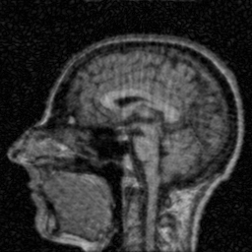






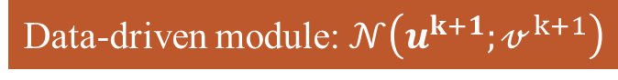
Our Paradigm Prior Module
K-space sparse data
Zero-filled image as input
zero filled image
Rough reconstruction of fidelity module
Fidelity module: $ℱ\left(α^{k};ρ\right)$
Data-driven module:$𝒩\left(u^{k+1};𝓋^{k+1}\right)$
Artifacts removal by data-driven module
Fidelity module:$𝒞\left(v^{k+1};α^{k}\right)$
Prior module: $𝒫\left(w^{k+1};η_{2}\right)$
Details restoration by prior module
reconstructed MRI X

Slide 18
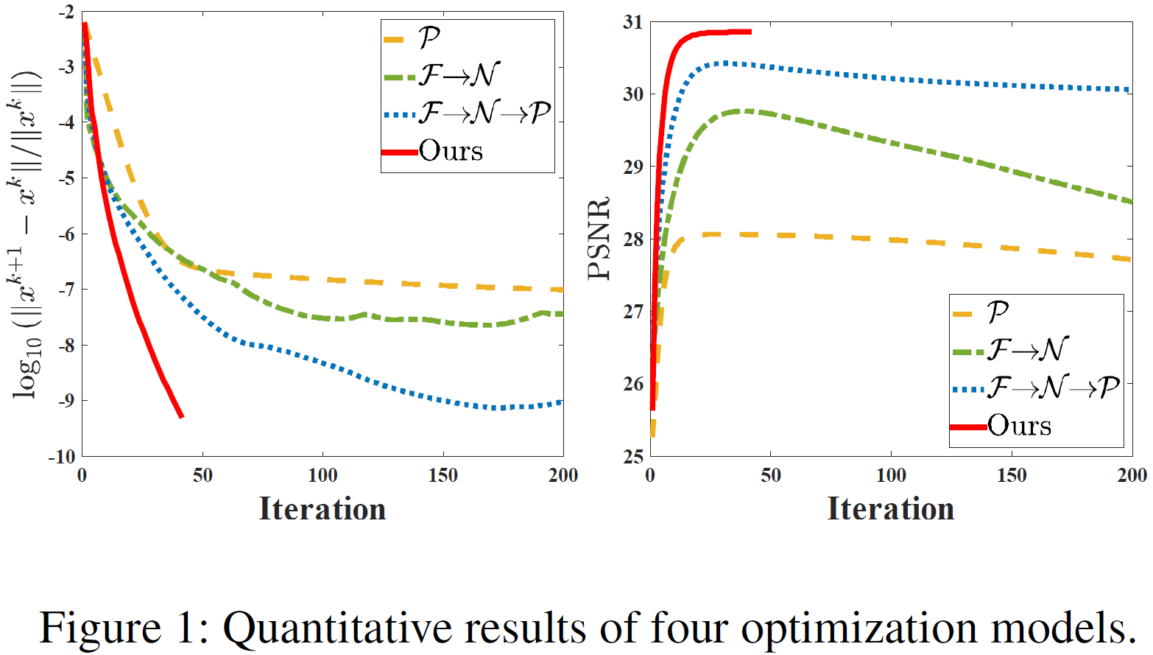










Our Paradigm Experiments
$$ℱ\left(α^{k};ρ\right)$$
$$ℱ\left(α^{k};ρ\right)$$
$$𝒩\left(u^{k+1};𝓋^{k+1}\right)$$
$$ℱ\left(α^{k};ρ\right)$$
$$𝒩\left(u^{k+1};𝓋^{k+1}\right)$$
$$𝒞\left(v^{k+1};α^{k}\right)$$
$𝒫\left(w^{k+1};η_{2}\right)$
$$𝒩\left(u^{k+1};𝓋^{k+1}\right)$$
$𝒫\left(w^{k+1};η_{2}\right)$
$𝒫\left(w^{k+1};η_{2}\right)$

Slide 19
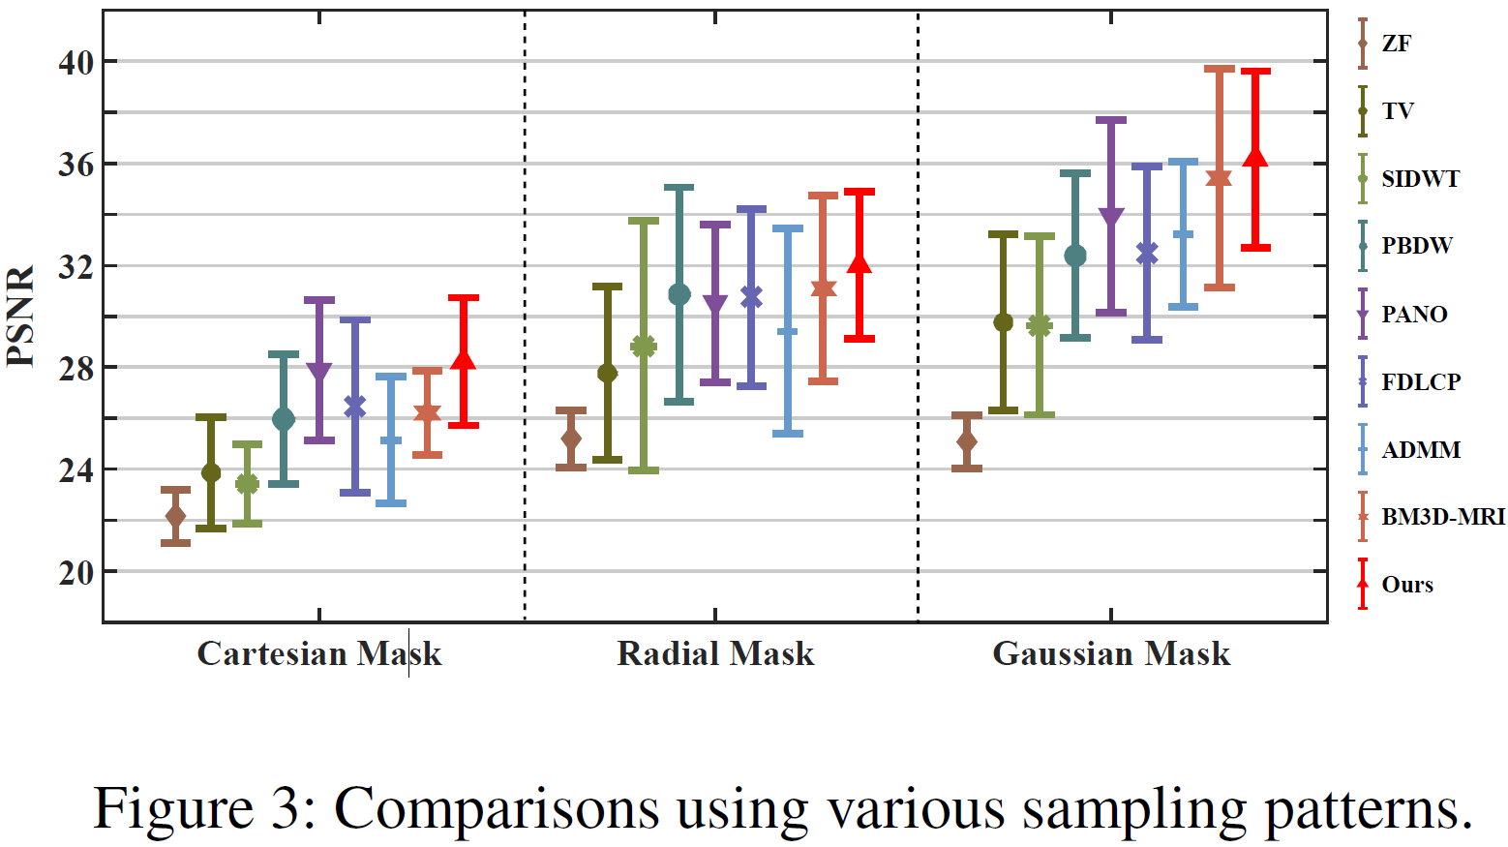
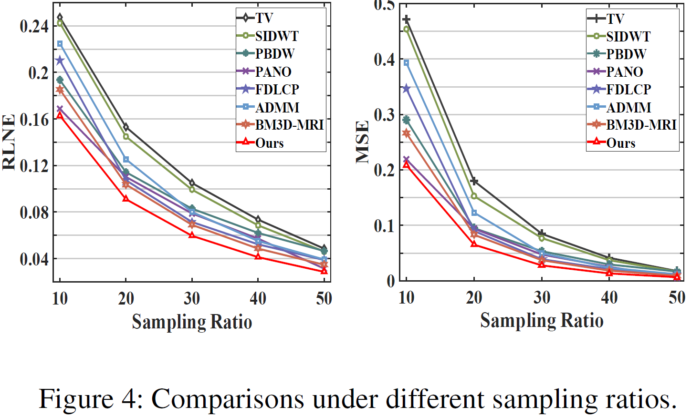
Our Paradigm Experiments
Ability to handle different sampling ratios and sampling patterns
Highest reconstruction accuracy
Lowest reconstruction error
Strongest robustness to variation of sampling patterns and ratios

Slide 20
Our Paradigm Experiments
Comparison of Execute Time (s)
Sampling Rate | Data | ZF | TV | SIDWT | PBDW | PANO | FDLCP | ADMM-Net | BM3D-MRI | Ours
10% | T1w | 0.0035 | 2.0098 | 14.8269 | 45.2639 | 27.9626 | 84.8494 | 1.2332 | 10.8777 | 0.3167
 | T2w | 0.003 | 2.3625 | 20.9462 | 53.0273 | 42.9235 | 84.1869 | 1.2349 | 9.5716 | 0.3631
50% | T1w | 0.0032 | 0.7631 | 5.5761 | 26.1274 | 11.1466 | 83.068 | 1.2499 | 11.5394 | 0.5633
 | T2w | 0.0036 | 0.7013 | 5.7678 | 24.8526 | 14.4659 | 81.8903 | 1.2445 | 10.6671 | 0.5545
Notice that ADMM-Net and ours are tested on GPU.
The proposed framework can ideally provide a efficient reconstruction process and comes to the fastest method among the competitors.

Slide 21
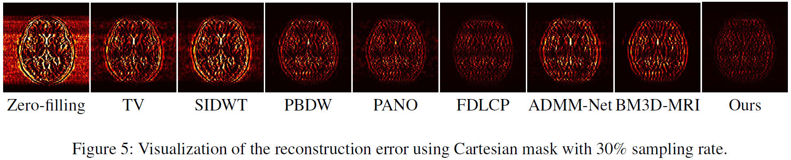
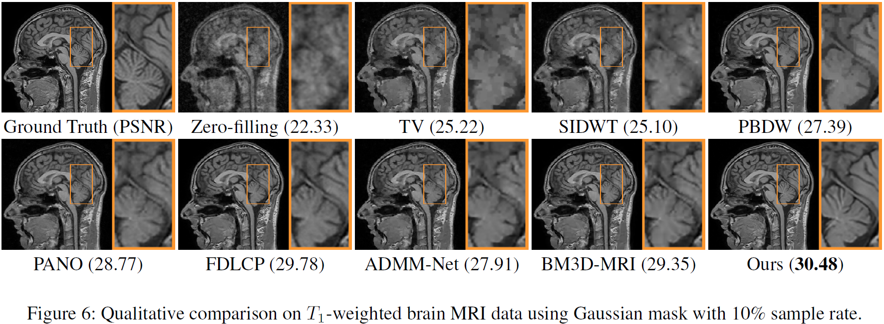
Our Paradigm Experiments
Visualization comparison

Slide 22
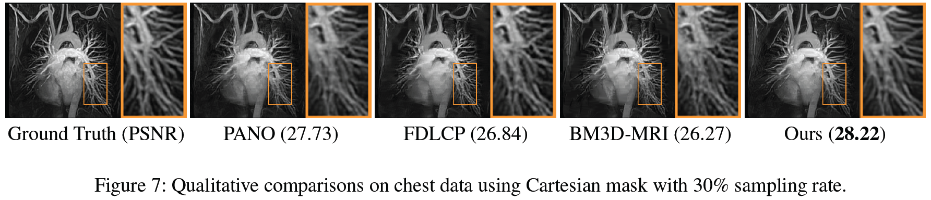
Our Paradigm Experiments
Robust to various kinds of testing data
Data | ZF | TV | SIDWT | PBDW | PANO | FDLCP | ADMM-Net | BM3D-MRI | Ours
Chest | 22.95 | 24.43 | 24.17 | 25.91 | 27.73 | 26.84 | 25.38 | 26.27 | 28.22
Cardiac | 23.40 | 29.17 | 27.49 | 31.34 | 33.14 | 33.84 | 31.42 | 31.44 | 35.69
Renal | 24.32 | 28.77 | 27.66 | 31.05 | 32.21 | 33.74 | 31.13 | 31.01 | 34.79

Slide 23
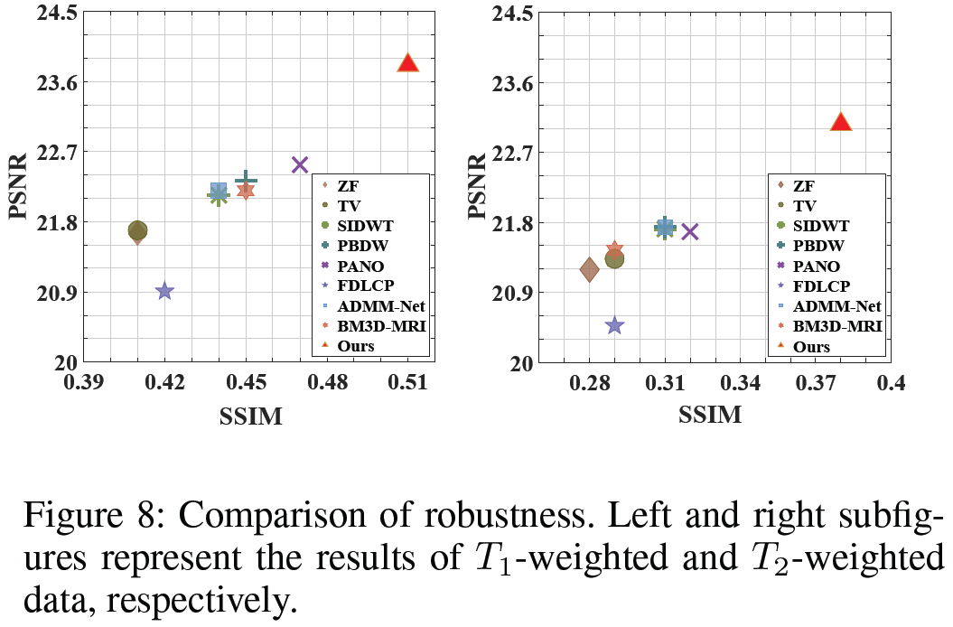
Our Paradigm Experiments
Robust to Rician noise pollution
our method has a better noise tolerance than the others,

Slide 24
Real-world
CS-MRI with Rician Noise

Slide 25
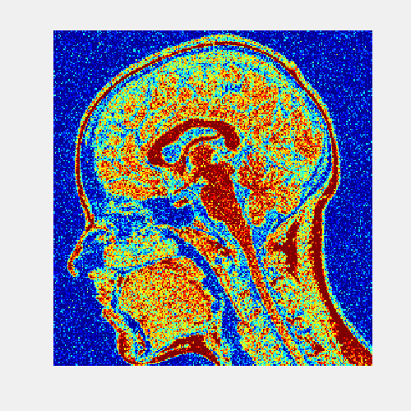
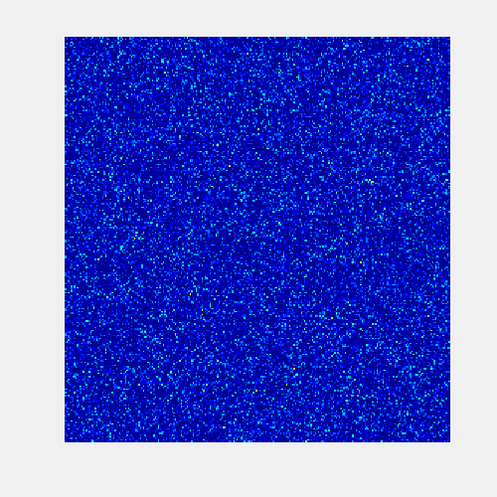
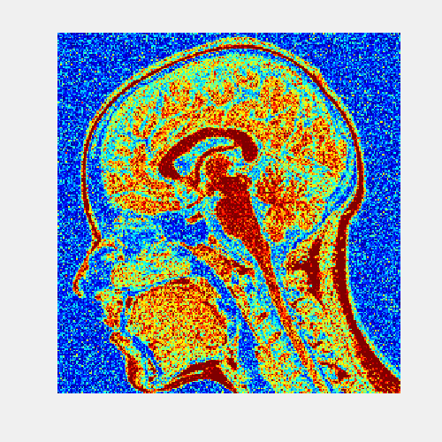
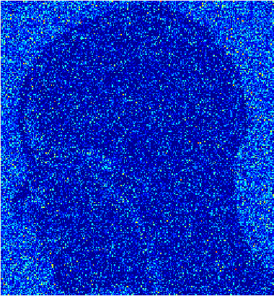
CS-MRI with Rician Noise Rician Noise
Rician Noise
MRI scanners acquire complex data where both real and imaginary parts are corrupted with zero-mean uncorrelated Gaussian noise with equal variance.
The calculation of the magnitude image transforms the original complex Gaussian noise into Rician noise.
Rician Noise for magnitude MR image
Guassian Noise
noisy image - clean image
Rician Noise
noisy image - clean image
Rician noise is not additive noise

Slide 26
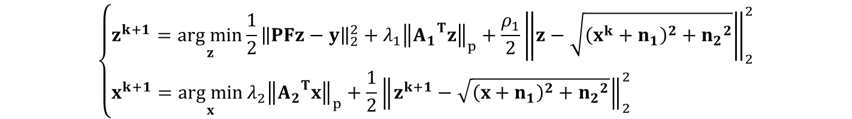
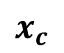
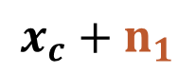
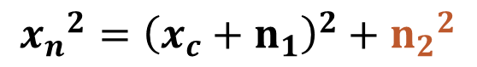
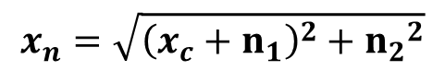
CS-MRI with Rician Noise Optimization
Alternating over two sub-problems
$$\left\{\begin{aligned}z^{k+1}=\underset{z}{arg min}{{\frac{1}{2}\left\|PFz−y\right\|}_{2}^{2}+{λ_{1}\left\|{A_{1}}^{T}z\right\|}_{p}+\frac{ρ_{1}}{2}{\left\|z−\sqrt{{\left(x^{k}+n_{1}\right)}^{2}+{n_{2}}^{2}}\right\|}_{2}^{2}} \\ x^{k+1}=\underset{x}{arg min}{{λ_{2}\left\|{A_{2}}^{T}x\right\|}_{p}+\frac{1}{2}{\left\|z^{k+1}−\sqrt{{\left(x+n_{1}\right)}^{2}+{n_{2}}^{2}}\right\|}_{2}^{2}} \end{aligned}\right.$$
Noisy image reconstruction
Clear image reconstruction
Learnable architecture for Rician noise removal
$$x_{n}=\sqrt{{\left(x_{c}+n_{1}\right)}^{2}+{n_{2}}^{2}}$$
Rician noise
Gaussian noise
Clean image
$${x_{n}}^{2}={\left(x_{c}+n_{1}\right)}^{2}+{n_{2}}^{2}$$
ResNet 1
$$x_{c}+n_{1}$$
ResNet 2
$$x_{c}$$

Slide 27
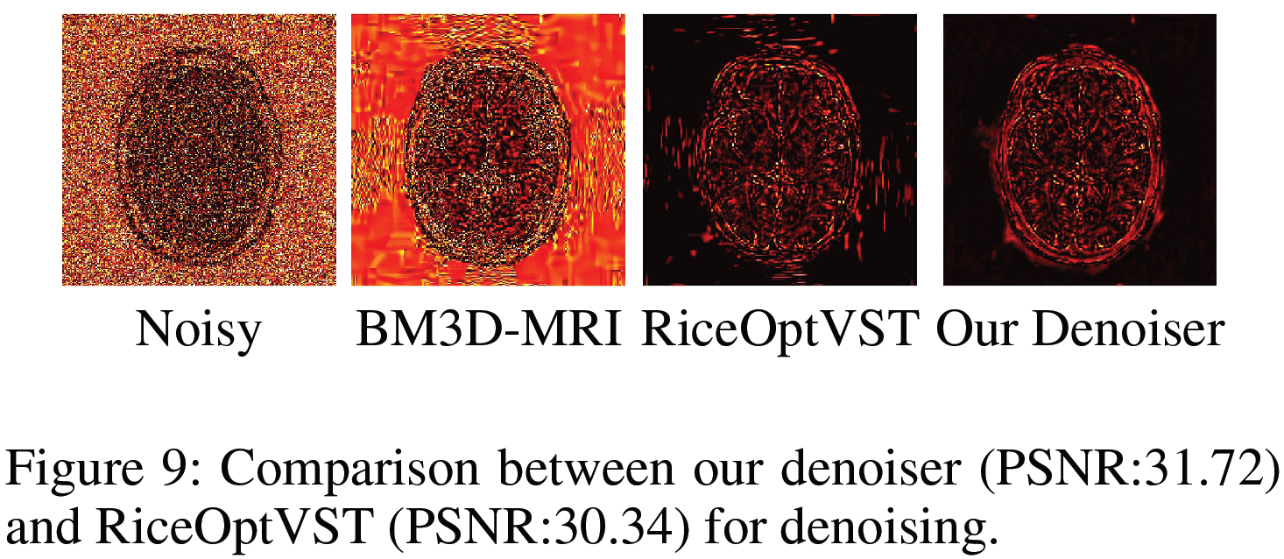
CS-MRI with Rician Noise Experiments
Comparison with classical Rician noiser remover
The choice of taking our learnable architecture as denoiser performs better than that of taking RiceOptVST.

Slide 28
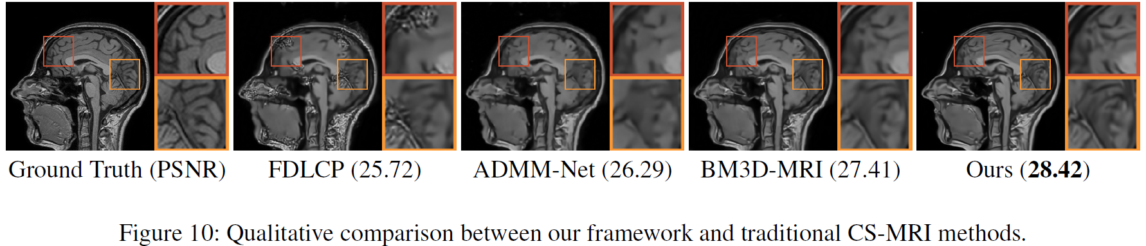
CS-MRI with Rician Noise TwoNets_CS+Denoising
Comparison with traditional CS-MRI methods followed by a denoiser
Data | Denoiser | Zero-Filling | TV | SIDWT | PBDW | PANO | FDLCP | ADMM-Net | BM3D-MRI | Ours
T1w | RiceOptVST | 24.11 | 25.51 | 25.78 | 26.65 | 27.08 | 20.71 | 26.36 | 27.36 | 28.05
 | Ours | 24.62 | 25.71 | 25.94 | 26.83 | 27.30 | 25.42 | 26.49 | 27.64
T2w | RiceOptVST | 25.40 | 27.83 | 28.37 | 29.13 | 29.22 | 20.34 | 29.14 | 29.67 | 30.77
 | Ours | 26.36 | 28.20 | 28.68 | 29.46 | 29.64 | 27.21 | 29.45 | 30.34
Notes:
该图比较了“先重建后去噪”（A+B）与我们提出的迭代框架（A○B）的性能。
横坐标为B选RiceOptVST的情况，纵坐标为B选TwoNets的情况，黄色三角形”Ours“表示A○B的情况，
可以看出对于A+B的形式，B选取TwoNets时重建结果更好，而A○B形式的重建结果则比A+B好

Slide 29
Conclusions
Efficiency
Deep optimization algorithms for CS-MRI reconstruction
Accuracy
Both model based and data dependent prior knowledge are utilized
Convergence
Automatic checking and feedback mechanism for error-control
Robustness
Extended scheme for real-world CS-MRI with Rician noise.

Slide 30
Thanks
AAAI-19: Thirty-Third AAAI Conference on Artificial Intelligence
rsliu@dlut.edu.cn
yuxizhang@mail.dlut.edu.cn
shichao.cheng@outlook.com
xin.fan@dlut.edu.cn
zxluog@dlut.edu.cn

